Slide 1
Compiler course
1. Introduction

Slide 2
Outline
Scope of the course
Disciplines involved in it
Abstract view for a compiler
Front-end and back-end tasks
Modules

Slide 3
Course scope
Aim:
  To learn techniques of a modern compiler
Main reference:
  Compilers – Principles, Techniques and Tools, Second Edition by Alfred V. Aho, Ravi Sethi, Jeffery D. Ullman
Supplementary references:
  Modern compiler construction in Java 2nd edition
  Advanced Compiler Design and Implementation by Muchnick

Slide 4
Introduction to Compilers
Hello learners, Today we will learn very important topic of computer science. That is compilers. Before starting formal and technical aspect of the subject lets discuss some interesting facts about compilers. The first compilers are believed to be appeared in the early 1950s. It was fortran compiler and it took approx. 18 staff-years to implement.
Compiler writing needs some background knowledge of programming languages, machine architecture, language theory, algorithms and software engineering.
Fortunately we have some few techniques that can be used to construct compilers for variety of languages and machines.

Slide 5
Cont..
Compilers are sometimes classified as single pass, multi-pass, load and go, debugging or optimizing. It depends upon how they have been constructed or what function they are supposed to perform.
Compiler is a program that reads a program written in one language-the source language and translates into an equivalent program in another language say target language. As an important function of this translation the compiler must also report to its users the presence or absence of errors.
At first glance you may think that variety of compilers are overwhelming. There are thousands of source languages, ranging from traditional languages such as C , java to specialized languages. Target languages are equally varied. But basic tasks of all such compilers are basically the same and by understanding these tasks compilers for wide variety of source languages and target languages.

Slide 6
Subjects
Lexical analysis (Scanning)
Syntax Analysis (Parsing)
Syntax Directed Translation
Intermediate Code Generation
Run-time environments
Code Generation
Machine Independent Optimization

Slide 7
Terminology
Compiler:
  a program that translates an executable program in one language into an executable program in another language
  we expect the program produced by the compiler to be better, in some way, than the original
Interpreter:
  a program that reads an executable program and produces the results of running that program
  usually, this involves executing the source program in some fashion
Our course is mainly about compilers but many of the same issues arise in interpreters

Slide 8
Disciplines involved
Algorithms
Languages and machines
Operating systems
Computer architectures

Slide 9
Abstract view
Source
code
Compiler
Machine
code
errors
Recognizes legal (and illegal) programs
Generate correct code
Manage storage of all variables and code
Agreement on format for object (or assembly) code

Slide 10
Front-end, Back-end division
Source
code
Front end
IR
Back end
Machine
code
errors
Front end maps legal code into IR
Back end maps IR onto target machine
Simplify retargeting
Allows multiple front ends
Multiple passes -> better code

Slide 11
Front end
Source
code
Scanner
tokens
Parser
IR
errors
Recognize legal code
Report errors
Produce IR
Preliminary storage maps

Slide 12
Front end
Source
code
Scanner
tokens
Parser
IR
errors
Scanner:
  Maps characters into tokens – the basic unit of syntax
    x = x + y becomes <id, x> = <id, x> + <id, y>
  Typical tokens: number, id, +, -, *, /, do, end
  Eliminate white space (tabs, blanks, comments)
A key issue is speed so instead of using a tool like LEX it sometimes needed to write your own scanner

Slide 13
Front end
Source
code
Scanner
tokens
Parser
IR
errors
Parser:
  Recognize context-free syntax
  Guide context-sensitive analysis
  Construct IR
  Produce meaningful error messages
  Attempt error correction
There are parser generators like YACC which automates much of the work

Slide 14
Front end
Context free grammars are used to represent programming language syntaxes:
<expr> ::= <expr> <op> <term> | <term>
<term> ::= <number> | <id>
<op> ::= + | -

Slide 15
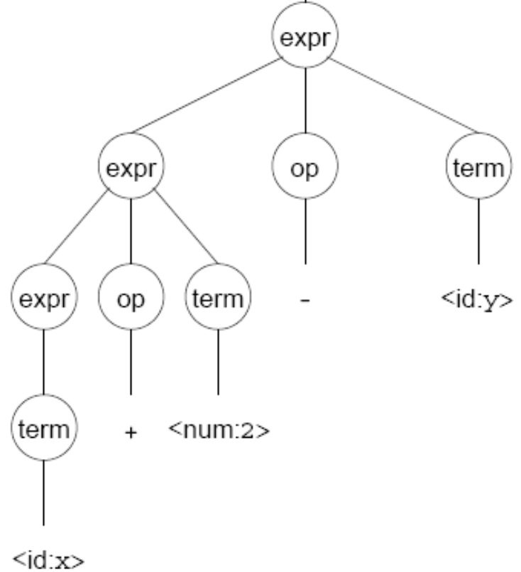
Front end
A parser tries to map a program to the syntactic elements defined in the grammar
A parse can be represented by a tree called a parse or syntax tree

Slide 16
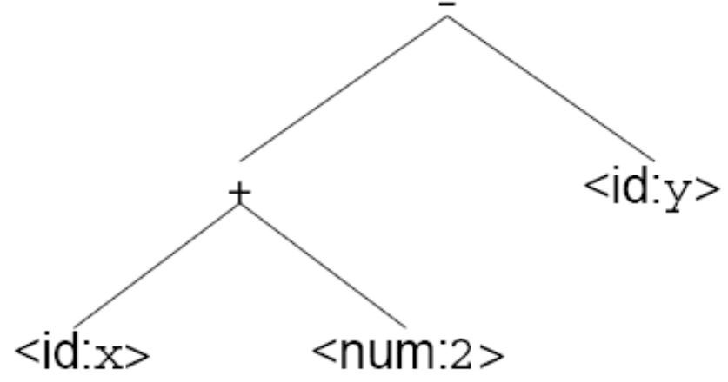
Front end
A parse tree can be represented more compactly referred to as Abstract Syntax Tree (AST)
AST is often used as IR between front end and back end

Slide 17
Back end
Instruction
selection
Register
Allocation
Machine code
IR
errors
Translate IR into target machine code
Choose instructions for each IR operation
Decide what to keep in registers at each point
Ensure conformance with system interfaces

Slide 18
Back end
Instruction
selection
Register
Allocation
Machine code
IR
errors
Produce compact fast code
Use available addressing modes

Slide 19
Back end
Instruction
selection
Register
Allocation
Machine code
IR
errors
Have a value in a register when used
Limited resources
Optimal allocation is difficult

Slide 20
Traditional three pass compiler
Source
code
Front end
IR
Middle
end
IR
Back end
Machine
code
errors
Code improvement analyzes and change IR
Goal is to reduce runtime

Slide 21
Middle end (optimizer)
Modern optimizers are usually built as a set of passes
Typical passes
  Constant propagation
  Common sub-expression elimination
  Redundant store elimination
  Dead code elimination

Slide 22
Readings
Chapter 1 of the book

